Slide 1
Group-1
CALL DATA RECORD
TEAM MEMBERS :-
Deepanshu Gupta 46368593
Ayushi Srivastav 46368602
Dhruv Singhal 46368605
Rishav Kumar Dubey 46368606
Kanak Sharma 46368607
Anmol Yadav 46368608
Harshkumar Hemantkumar Patel 46368729

Slide 2
Requirements:-
1. Client-Server Connection
2. Display menu
a. Login
b. Sign Up
3.Successful login
a. Processing CDR file
b. Perform Customer and interoperator billing operations

Slide 3
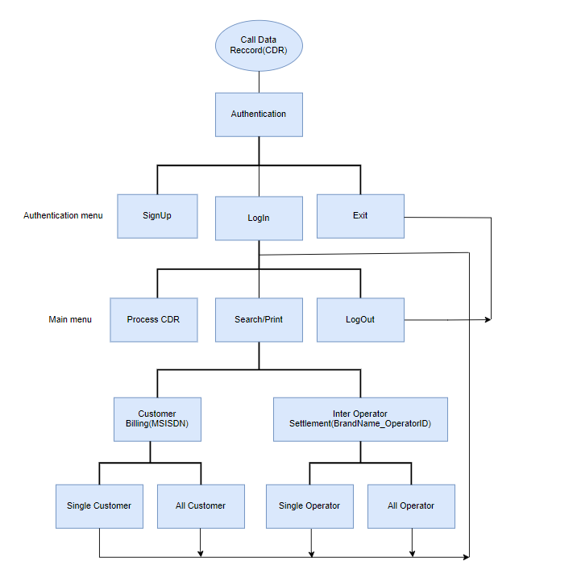
Rough Idea

Slide 4
Authentication Menu
Options provided in Authentication menu are
Sign Up – Users can signup to use the operation functions.
Login- Already existing users login using username and password.
Exit

Slide 5
Main Menu
Options provided in the main menu are-
Process CDR file
Performs the billing operations
Logout – Goes back to the authentication menu

Slide 6
Process CDR File
Given input pipe separated file will get processed, below is an example illustrating the function and processing.
Formatted string
1037928
Jio
42502
SMS-MT
0
0
0
1136404
42504
Initial
1037928|Jio|42502|SMS-MT|0|0|0|1136404|42504

Slide 7
Billing operations
Two types of billing will be performed
1. Customer Billing-
a. For a particular customer, search using MSISDN.
b. Store the information of all customer data in file and download it
2. Interoperater Billing
a. Print information about a particular interoperator using MMC code
b. Store information of all operators and download it as a file.

Slide 8
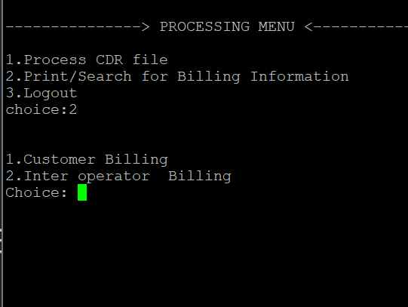
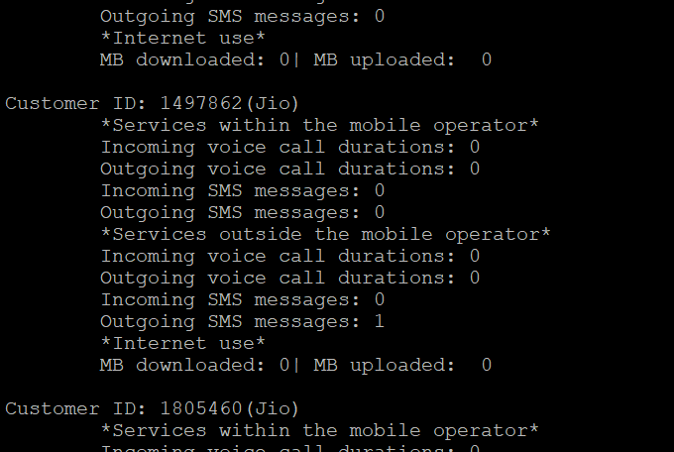
Output Snapshots:-
Snapshot of Processing Menu
Snapshot of the file that contains data of customer billing.

Slide 9
THANKYOU

